Slide 1
Anti-neoplastic agents i
Dr. Rajpushpa Labh
Department of Pharmacology, UCMS Delhi

Slide 7
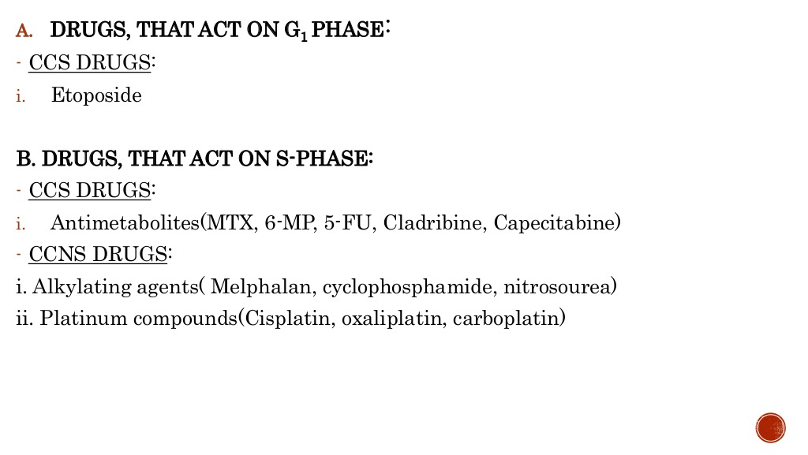
5 FU = 5 Fluorouracil
6 MP = 6 Mercaptopurine
MTX = Methotrexate

Slide 8
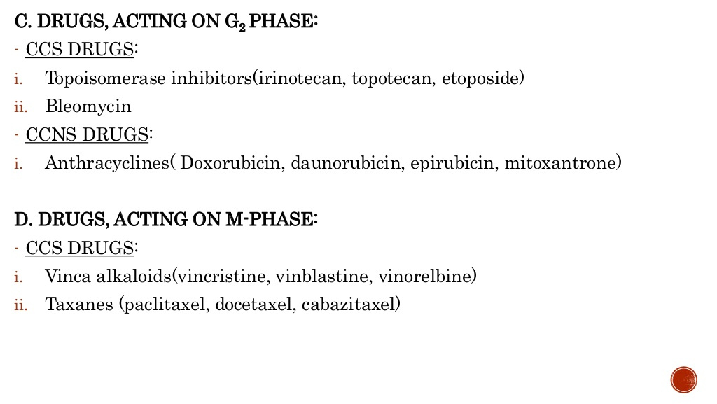

Slide 13
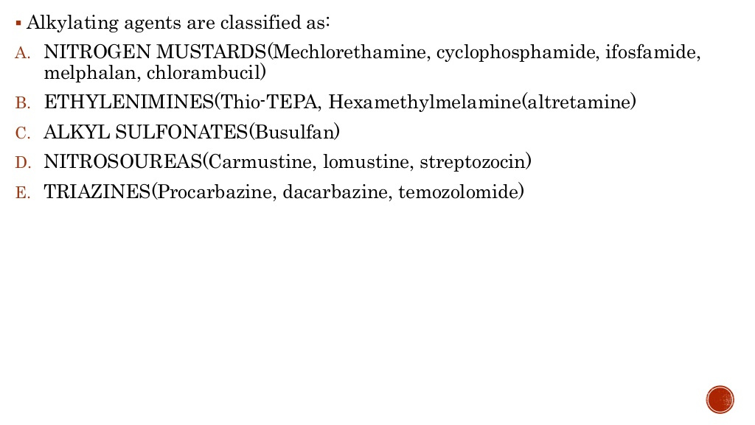

Slide 16
Drug of choice for Wegener’s Granulomatosis.

Slide 17
Bone marrow suppression.

Slide 19
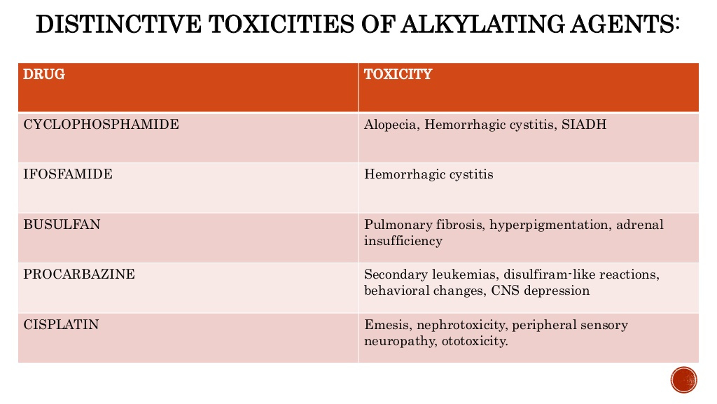

Slide 22
Bone marrow toxicity.
Bone marrow toxicity.)

Slide 23
nausea and vomiting.

Slide 24
Bone marrow toxicity.

Slide 26
5 FU = 5 Fluorouracil
6 MP = 6 Mercaptopurine
MTX = Methotrexate

Slide 28
Methotrexate (MTX) forms POLYGLUTAMATES inside the cell

Slide 32
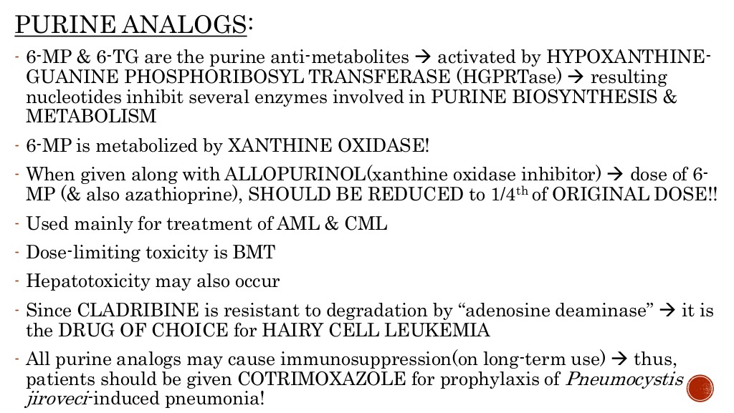
Bone marrow suppression.

Slide 33
Drug of choice for CLL

Slide 36
Drug of choice for Pancreatic cancer

Slide 40
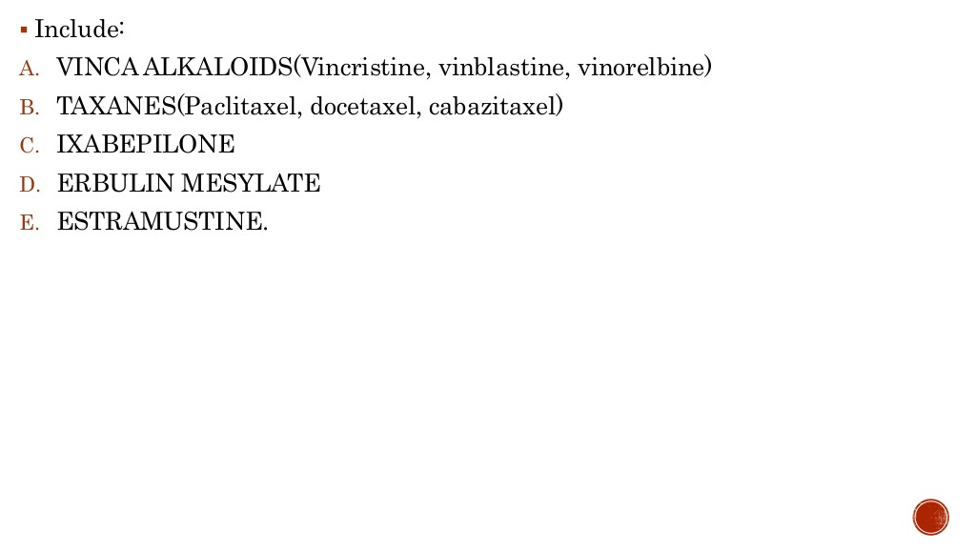

Slide 41
BONE marrow toxicity.

Slide 59
Thank you..!

